Slide 1
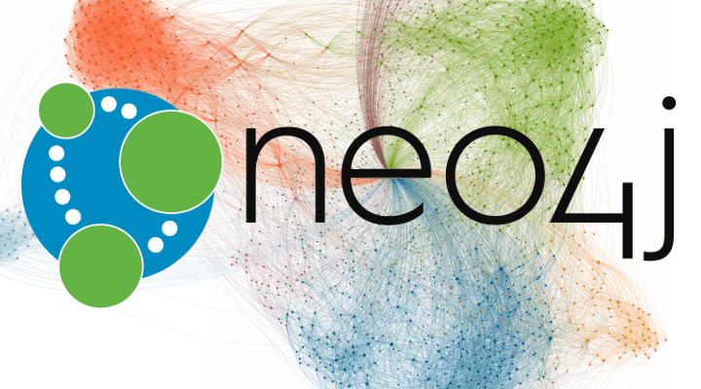
Intro to Neo4j and Graph Databases
Yingjia Zhai
Notes:
My final project is about Neo4j and graph databases.

Slide 2
CONTENTS
What is a Graph Database?
Use cases - Why Graphs?
Neo4j product overview
Cypher query language
Labeled property graph data model
The Movie Database
RDBMS to Graph
Neo4j in the NoSQL Ecosystem
Notes:
I would like to talk about the basics of what is a graph and what is graph database. After that, we will jump into some use cases where graphs make sense.
I will also go through with neo4j in detail including the data model, the query language and examples, then I will mention some dataset examples and resources there for neo4j and leave time for your questions.

Slide 3
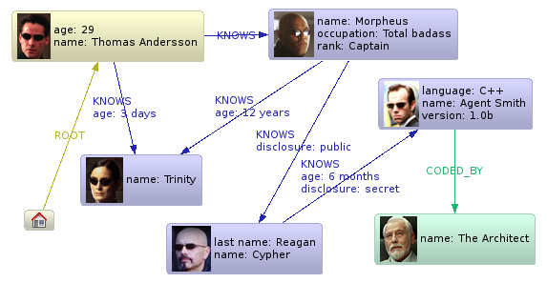
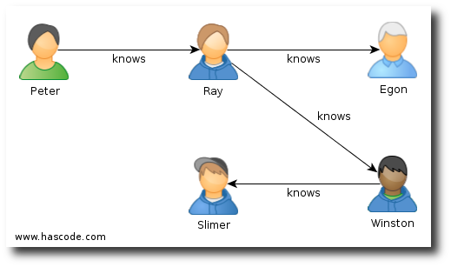
Graph(Database)
A Graph is Connected Data
Notes:
Here we are gonna clear some concepts, that graph is not a chart, but a connected data structure with nodes and relationships. So really a graph is a connected data. We have relationships connected these nodes. So for example, we can use graphs to talk about social networks.

Slide 4
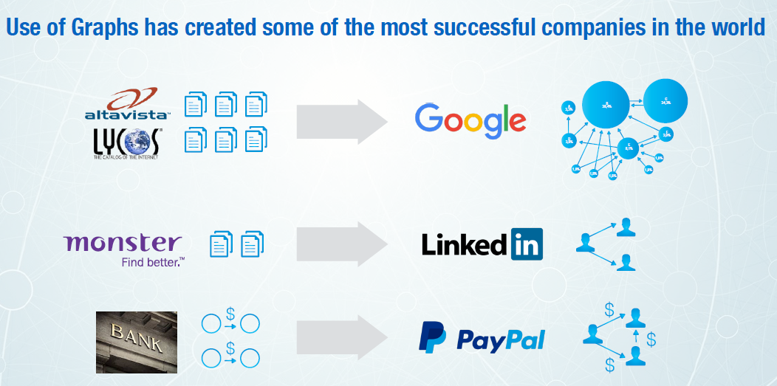
Notes:
If we look at companies that have made use of graphs, we will end up a lot of successful companies for example, google search engine is based on a graph of WebPages, LinkedIn has build professional social network based on graphs…

Slide 5
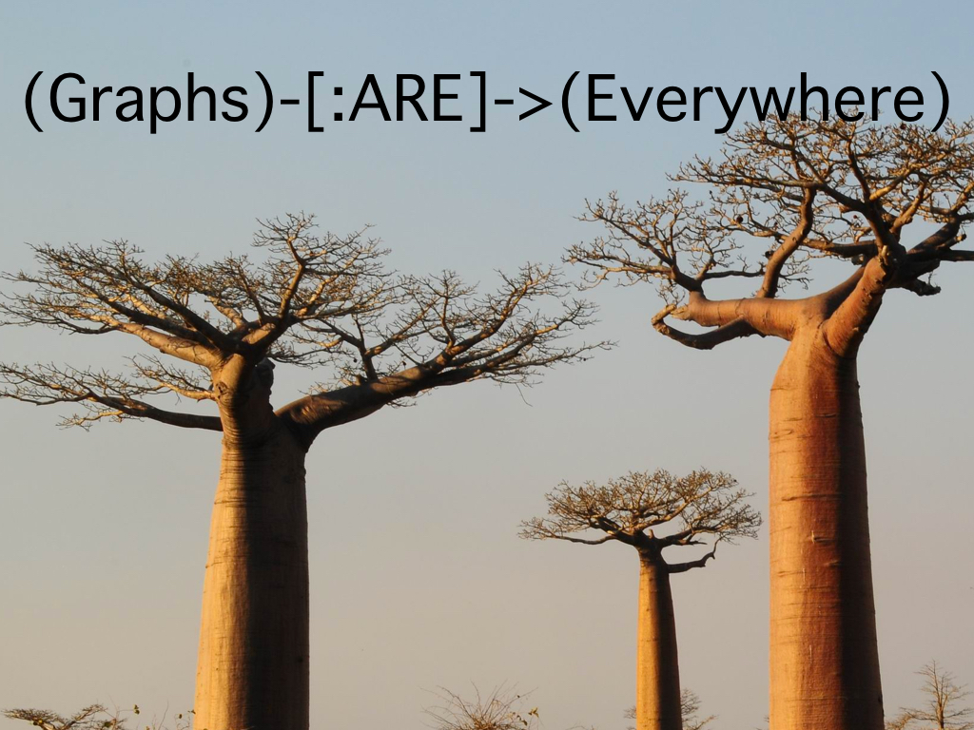
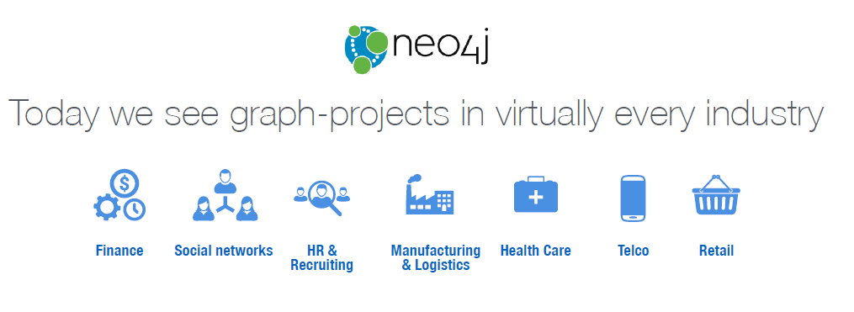
Notes:
And really we are seeing graphic projects in almost every industry you can think of Finance, Social networks, HR, Manufacturing, Healthcare, telecom, and retail.

Slide 6
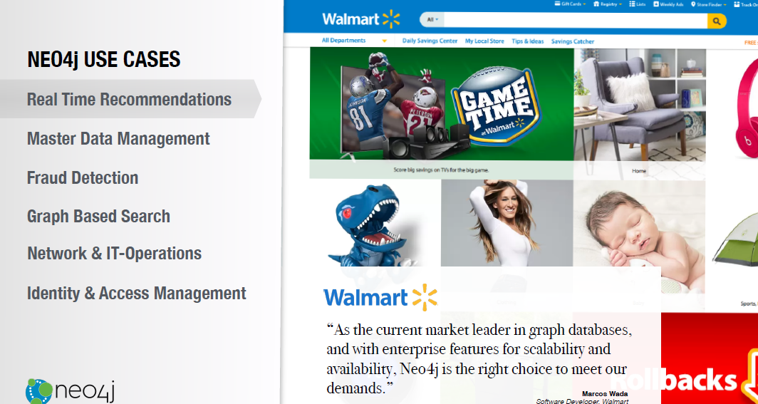
Notes:
Here we can see some specific use cases, For example, real time recommendations,
Amazon products we want to buy or Netflix movies we might be interested in watching, so this is a often based on a graph or a network users and the products we’ve interacted. Walmart.com is an example using neo4j for real time recommendations.

Slide 7
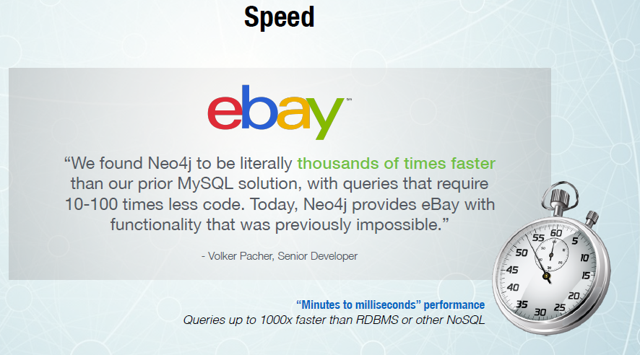
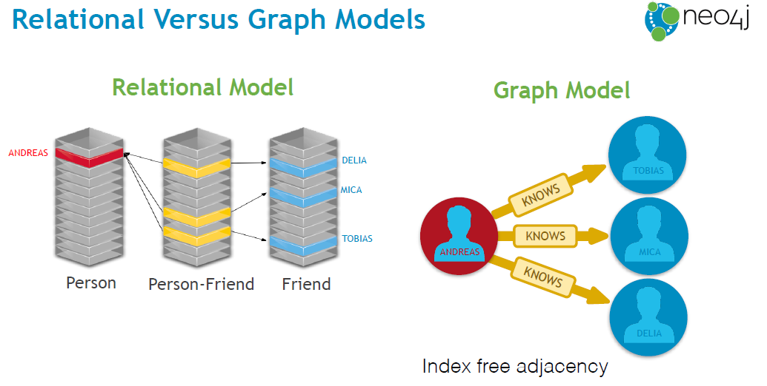
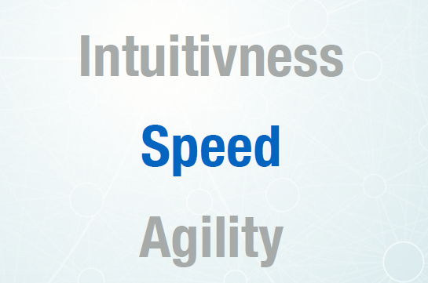
Why graphs
Notes:
Here we use speed as a benefit of using graphs, we have a simple social network graphs, with graphs, we can represent single relationship directly, however, with the relational database, we need to use a join table here, the query time will be slow.

Slide 8
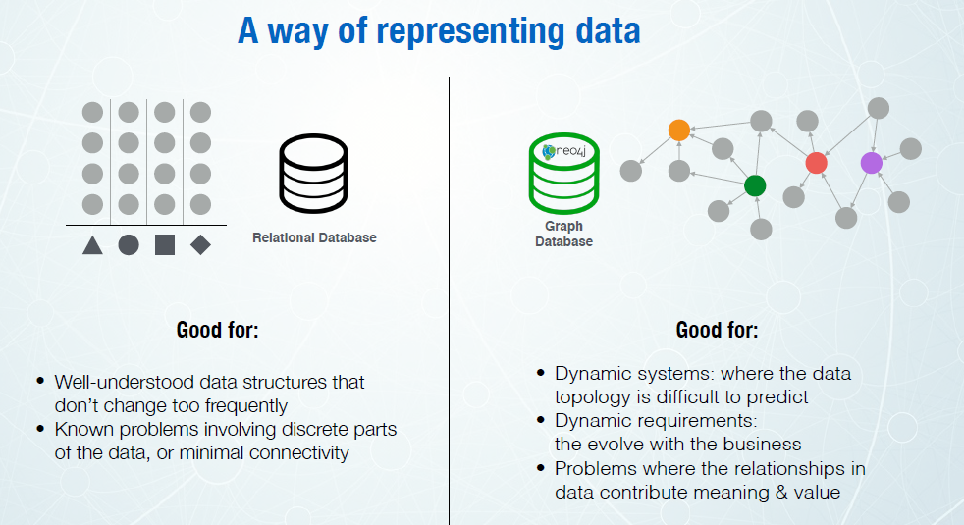
Notes:
A relationship data is very good for a well understood data structure that is not changing, we do not need to do lots of schema migrations, Contrast that a graph database is good for dynamic systems, where our data is changing or difficult to predict and we are really deriving a lot of value from the relationships in the data.

Slide 9
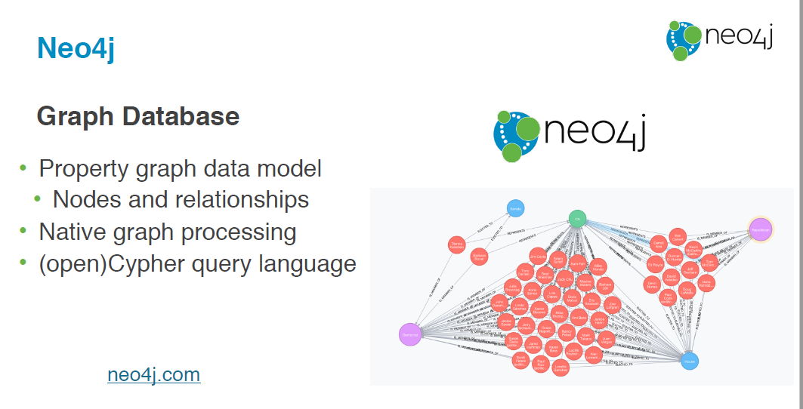
Notes:
Neo4j, the main components of neo4j is the property graph data model, made up of nodes and relationships, and the native graph processing that’s able to traverse the graph very efficiently using free adjacency(自由邻接).

Slide 10
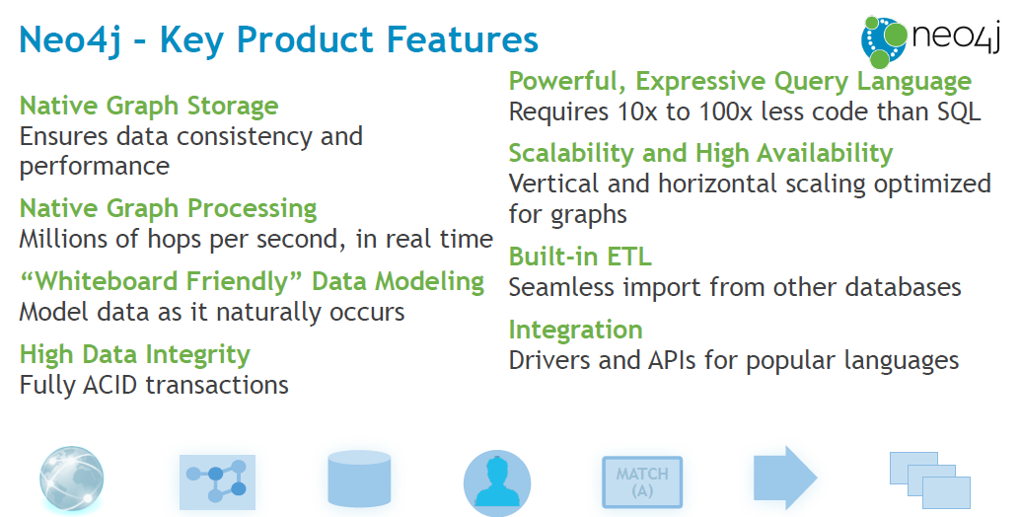

Slide 11
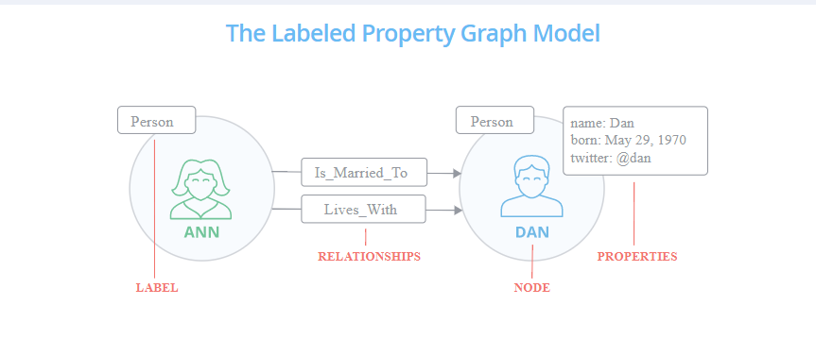
Labeled property graph data model
Properties
Label:person
Relationships
Node
Notes:
Let take a look into the data model in neo4j, and the example we use here is a happy couple, to see how we can represent this as a graph. The entities become a nodes, we have a relationship between ANN and Dan, we can add properties, which is key-value pairs, to these two nodes, their name and birthdays, and the label here is to define the class or the type of entities.

Slide 12
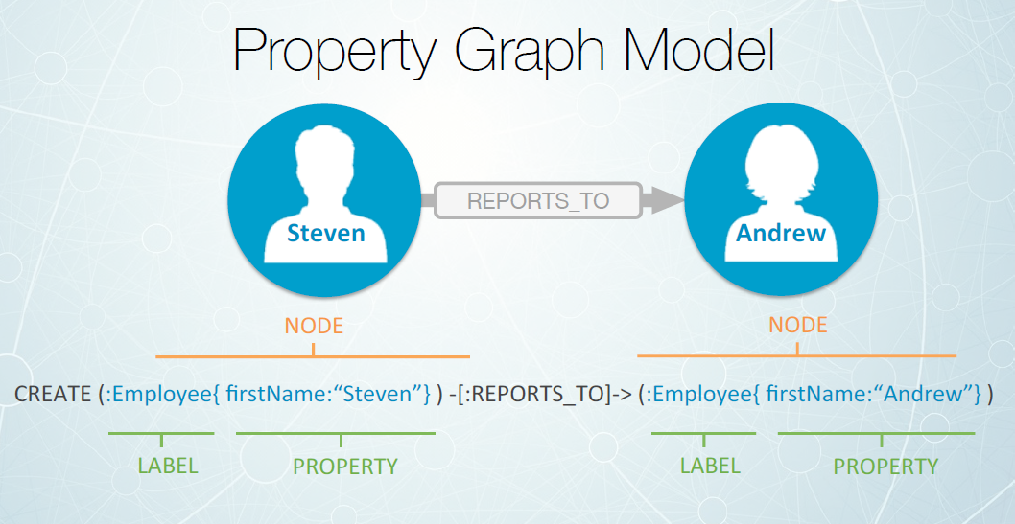
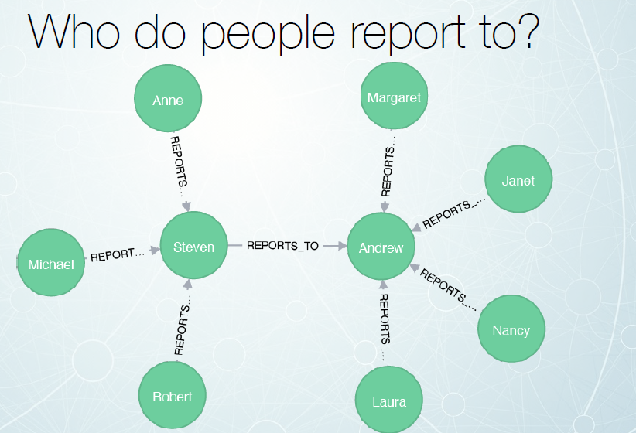
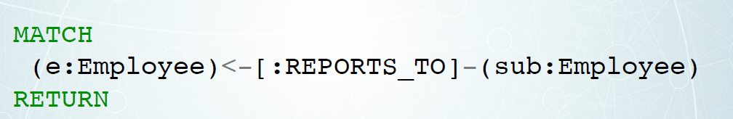
CYPHER
Neo4j has its own query language called Cypher. Cypher uses a similar syntax to SQL.
Notes:
Cypher is a query language that’s designed for graphs. Cypher is a SQL for graphs. Just take a very brief look here, going back to our data model, Cypher is all about pattern matching to define nodes and relationships.

Slide 13
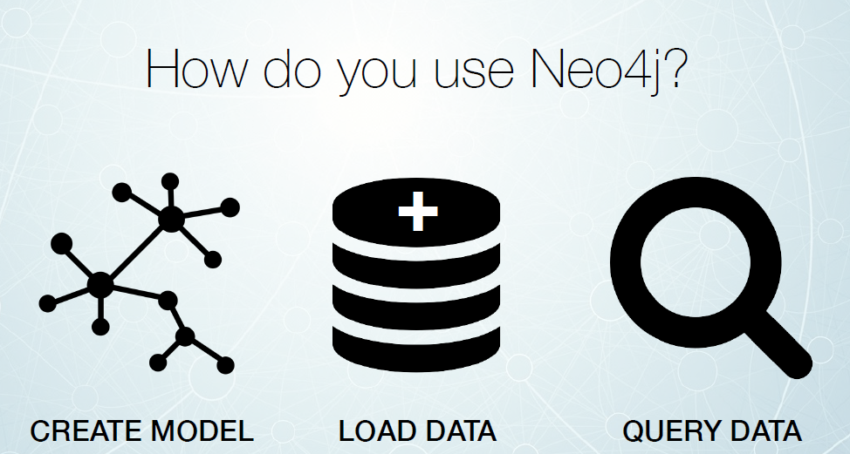
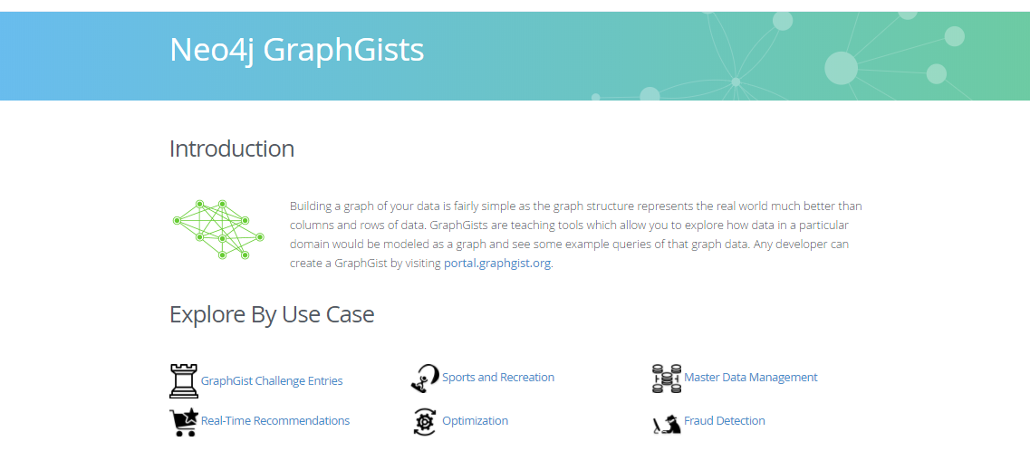
Movie Database and GraphGists
http://my-neo4j-movies-app.herokuapp.com/
Notes:
The basic idea here for building some applications, is creating model, loading data, and then querying the data.On Neo4j website you have a movie example dataset and there Neo4j GraphGists have a lot examples using neo4j.

Slide 14
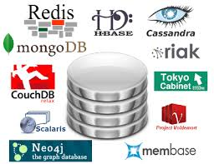
Neo4j in the NoSQL Ecosystem
Calculating average income?
Ask a relational database.
Building a shopping cart?
Use a key-value Store.
Storing structured product information?
Store as a document.
Describing how a user got from point A
to point B? Follow a graph.

